Slide 1
John 14: ¹⁵ “If you love me, you will keep my commandments. ¹⁶ And I will ask the Father, and he will give you another Advocate, to be with you forever. ¹⁷ This is the Spirit of truth, whom the world cannot receive, because it neither sees him nor knows him. You know him, because he abides with you, and he will be in you.

Slide 2
¹⁸ “I will not leave you orphaned; I am coming to you. ¹⁹ In a little while the world will no longer see me, but you will see me; because I live, you also will live. ²⁰ On that day you will know that I am in my Father, and you in me, and I in you. ²¹ They who have my commandments and keep them are those who love me; and those who love me will be loved by my Father, and I will love them and reveal myself to them.”

Slide 3
Reach the lost…
Raise disciples…
Relieve suffering…
All in the name of Jesus Christ our Lord.

Slide 4
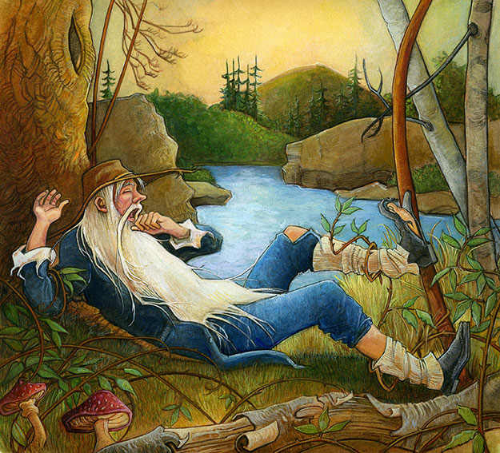
WHAT’S GOING ON?
CHURCH AND RIP VAN WINKLE
Slept through Revolution…

Slide 5
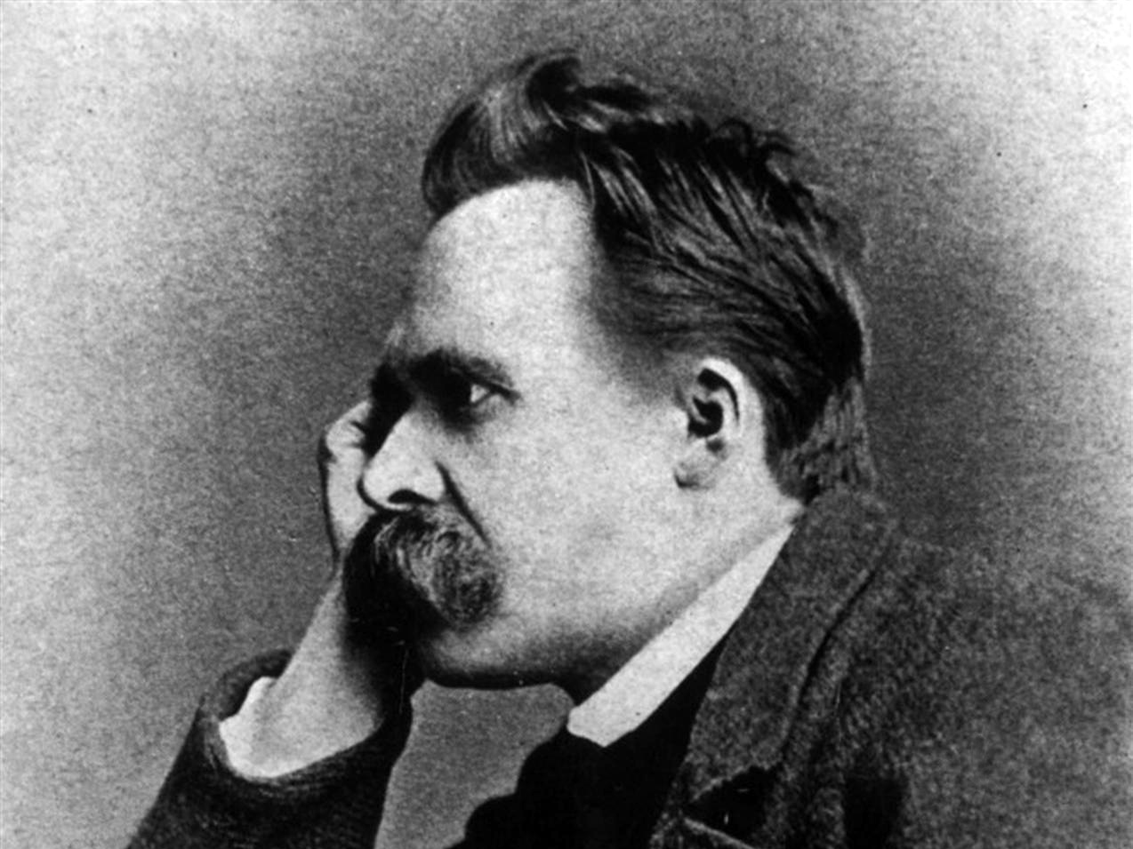
“God is dead.” Friedrich Nietzsche. (1882)

Slide 6
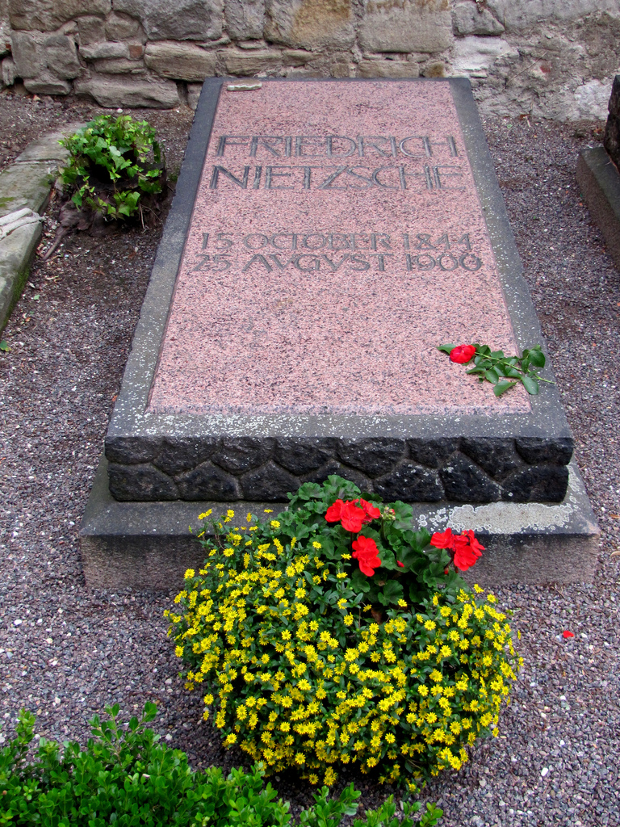
18 Years Later… “Nietzsche is dead.” God (August 25,1900)

Slide 7
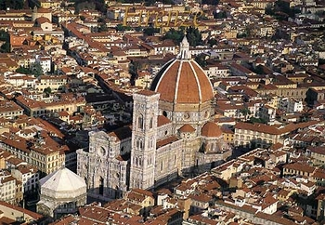

Slide 8
The “Church-Going Era”
The church used to be at the center of society
In the West, to be a citizen was to be a Christian
The church benefited (and grew!) because of this favorable place in society
The era peaked in U.S. around 1960 – and has declined ever since

Slide 9
How the Church-Going Era Affected Our Congregations
Our churches grew because going to church was just what we did
The church was “a place where we go for worship and other activities”
The unstated mission for most churches was “to be a good church home for the people of our denomination who moved to town”

Slide 10
Assumptions from the “Church-Going Era”
Once true but no longer…
“Going to church is just what people do.”
“All we need to do is let people know we are here and they will come visit.”
“The majority of people out there are looking for a church to join.”
“If someone is active in church programs, they will be fashioned into a disciple of Jesus.”

Slide 11
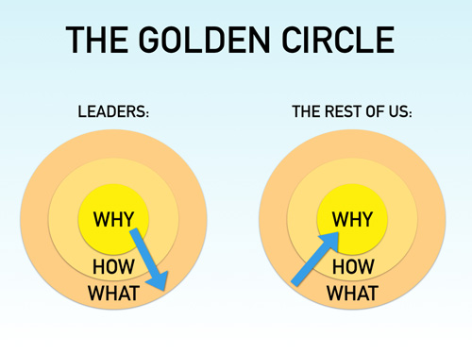
Don’t start with, “What?” (Church) Start with “Why?” (Raise Disciples)

Slide 12
Go, therefore, and make disciples
of all people…
Matthew 28
Assumption was…
Where we go is TO CHURCH…
WHAT? (CHURCH) WHY? (MAKE DISCIPLES)

Slide 13
Start with “Church” no longer naturally
Reaches the lost…
Raises disciples…
Relieves suffering…
All in the name of Jesus Christ our Lord.
Start with “Why?” does.

Slide 14
When we put, “What?” (Church) over “Why?” (Raising Disciples)…
Conflicts erupt over insignificant things
Institutional maintenance keeps us busy
We build high walls between our church and our neighborhood
Budgets focus money away from mission
Our comfort becomes the only measuring stick for what we do and don’t do

Slide 15
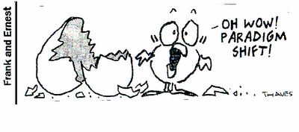
Three Discipleship Shifts . .
. .

Slide 16
Discipleship Shift # 1
From making good church members to making disciples of Jesus.
(No longer can we assume that church members naturally become disciples
if given enough time…)

Slide 17
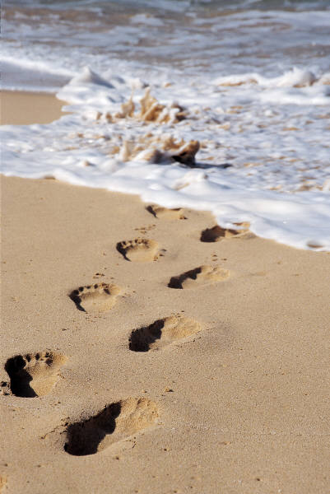
Discipleship Shift
Discipleship doesn’t just happen at church.
(notice in the picture, the footsteps are going into the ocean.)
Notes:
)

Slide 18
Membership Model Discipleship Model
Two Different Models for Our Church:
In what ways do we live out these models?
“I pay my tithe” therefore I should benefit (“My church.”)
The church serves its members
My pastor is responsible for my spiritual growth
Worship satisfies me
Majority rule decides (Agreement)
“I pay my tithe” to bless someone else. (Christ’s church for God’s purpose.)
The church serves the world (For God so loved)
I am responsible for my spiritual growth
Worship stretches me
Prayer decides (Alignment)

Slide 19
Membership Model Discipleship Model
Two Different Models for Our Church:
Don’t miss the call...
Members pick a church. (“You didn’t like your old church…”)
Pray to get God to fulfill our dreams.
Seek to be blessed by God.
Seek to give God a big, “Amen!”
Disciples are picked by God for God’s mission.
Pray to fulfill God’s dreams. (God didn’t have to have Moses.)
Seek to bless God.
Seek to get a big “Amen!” from God.

Slide 20
Vital Churches are “Changing the Scorecard”
Church mission is what the church does (Make Disciples), not a committee or division of the church.
Asking “How will our community and perhaps the world look different in 10 years if we follow God’s lead?”
Seeing local churches, businesses and schools as partners, not competitors
Blurring line between “Insiders” & “Outsiders” (Not who loves and affirms us but whom do we love and affirm.)

Slide 21
Holistic mission leads to partnership.
People who have the same goals you have are now united together in purpose.
Reach the lost…
Raise disciples…
Relieve suffering…
All in the name of Jesus Christ our Lord.

Slide 22
Discipleship Shift # 2
From church growth
to transformation of lives, communities, and the world.
If your church disappeared, how long until people found out, and when they found out, would they care? Would they cry?

Slide 23
Discipleship Shift # 3
From preserving the institution to preparing everyday missionaries to serve in a strange land.

Slide 24
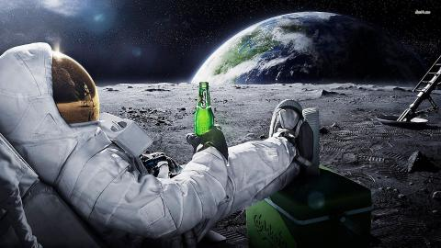
We are strangers in a strange land.
Imagine landing on the moon, surrounded by people you had never met. What would you do to build relationships with these people and start a church?

Slide 25
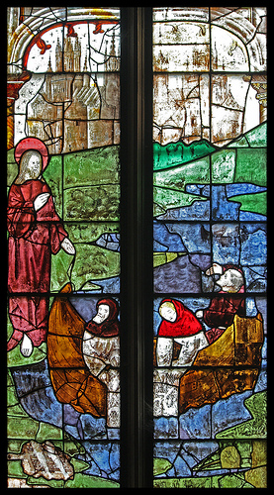
Closing the gap between Church Life & Real Life
Are lives more fulfilled, or just more full?
Are we training people to follow God’s call or are we asking them to fill slots on the church’s organizational chart?
Are we built of committees or teams?

Slide 26
Making disciples will look different today…
Society’s rapid change is affecting the Church
Generational differences
Racial/ethnic growth
Changing religious values

Slide 27
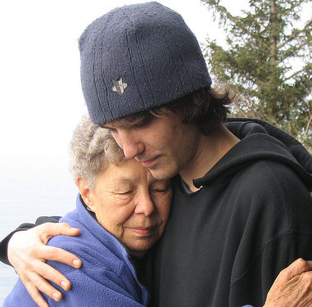
Generations Can Clash!
Committees are exercises in deferred pleasure
Hands-on work is preferred by younger groups
Approaches to worship are different
Older groups rely on consistency
Younger groups value newness
Christian formation/education styles
Older groups prefer lecture style
Younger groups prefer interaction

Slide 28
Making disciples will look different today…
Change will be necessary!
And yet many of today’s congregations are not willing to change. . .
In fact, many resist it!

Slide 29
Discipleship Shift:
From Change to Transformation
You can count on resistance to change.
In most cases, resistance to change is really a fear of losing something.
Bigger the change… stronger the resistance.

Slide 30
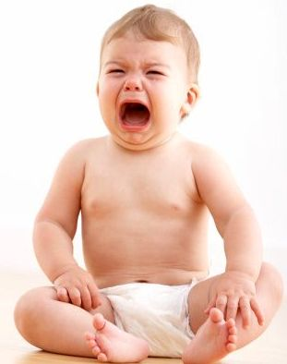
Making disciples involves transformation…
Change is what you do to a wet baby.
Transformation is what happens to disciples.
Romans 12:² Do not be conformed to this world, but be transformed by the renewing of your minds, so that you may discern what is the will of God—what is good and acceptable and perfect.

Slide 31
Discipleship Shifts . .
Humpty Dumpty…
What if Humpty Dumpty fell off the wall and then flew away? . .

Slide 32
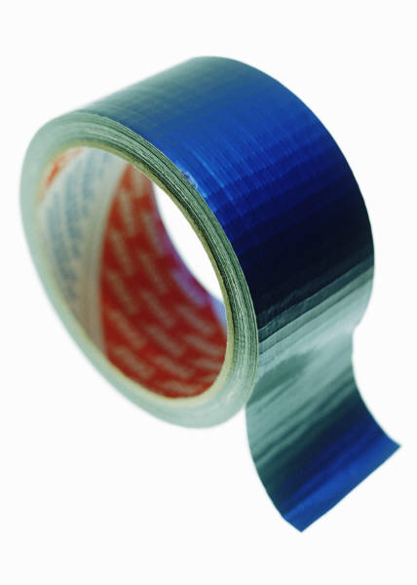
Beyond Duct Tape
Surface-level tinkering may provide immediate relief. . .
But a transformation
requires patience to notice the changing conditions and make bold decisions.

Slide 33
Solving Problems
Problem
Possible
Options
Status Quo
Solution

Slide 34
An Example of Solving Problems
Broken
Furnace
Repair or
Replace?
Warm
Sanctuary
New
Furnace

Slide 35
Adapting to Conditions
A
Whole New
Place
Informal, frequent conversations
Questioning assumptions
Learning new skills
Today
Seeing interconnectedness

Slide 36
Solving Problems
Adapting to Conditions
Sees issues as problems to be fixed
Focuses on potential solutions, decision & action
Goal is to return to status quo
Requires technical skill & past answers
Begins with seeing things as they are
Focuses on systemic relationships
Creates new reality
Requires patience, willingness to adapt & learn

Slide 37
Solving Problems
Adapting to Conditions
Tradition
Trend
Transformation

Slide 38
Don’t lose sight of the goal: Discipleship

Slide 39
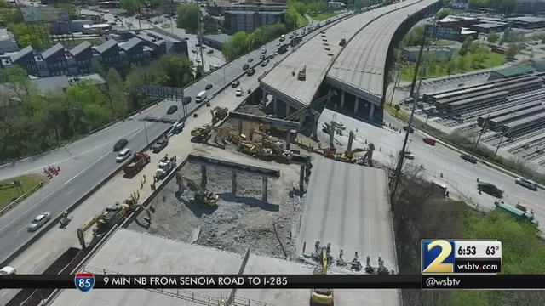
To follow Jesus, we must leave the highway…

Slide 40
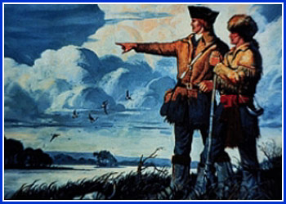
To follow Jesus, we must go like Lewis and Clark…

Slide 41
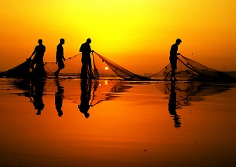
To follow Jesus, we must go like the first disciples… (leave our nets behind)

Slide 42
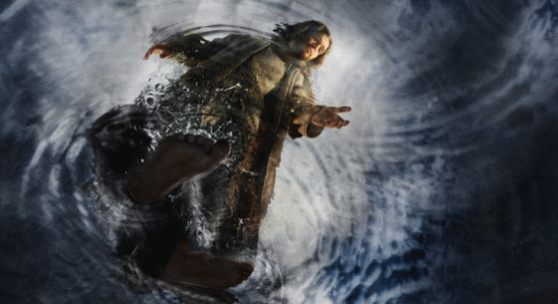
To follow Jesus, we must go like Peter (the disciple)…

Slide 43
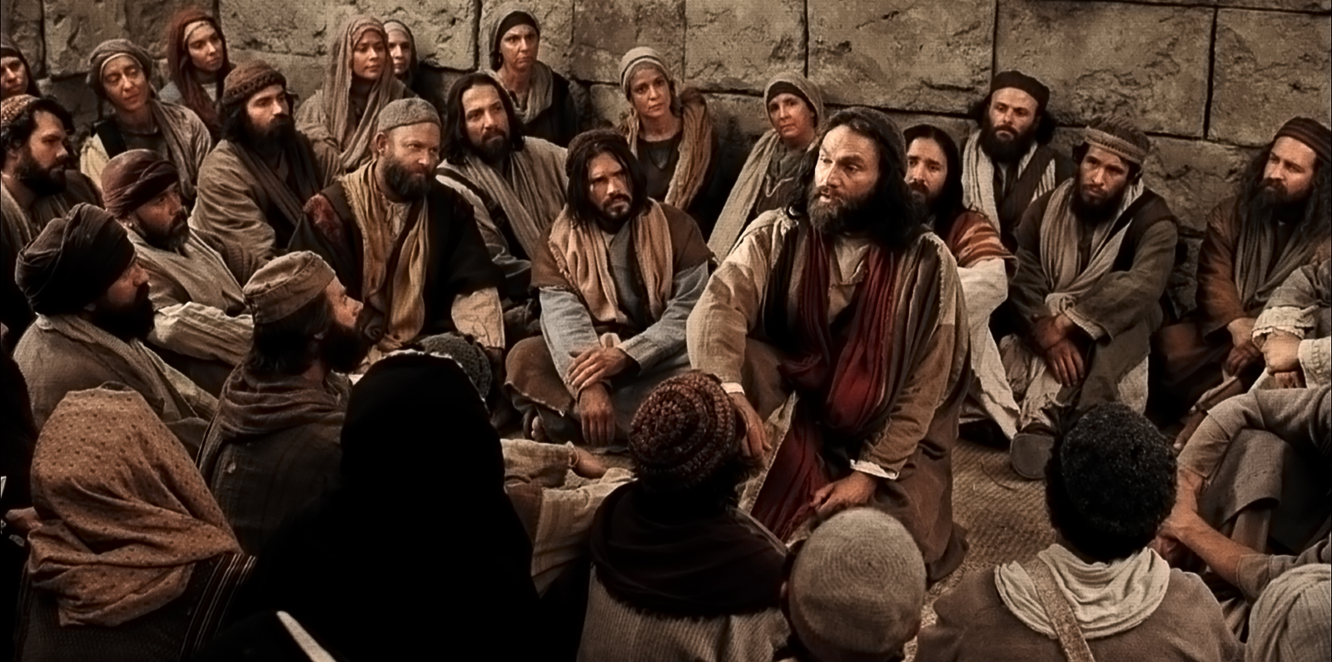
Not Peter the Apostle

Slide 44
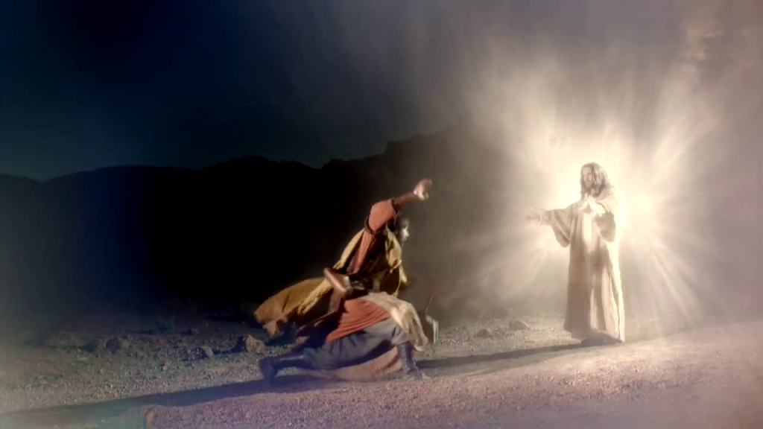
To follow Jesus, we must go like Paul… (“Fooled me once…”)

Slide 45
Remember!
We are not solving the problems of yesterday’s church.
We are adapting to a new way of doing God’s mission in the world!

Slide 46
Reach the lost…
Raise disciples…
Relieve suffering…
All in the name of Jesus Christ our Lord.

