Slide 1

Which center circle is larger?

Slide 2


Slide 3
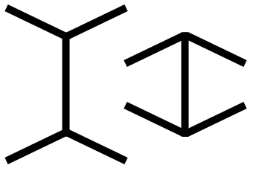
Which line is longer?

Slide 4
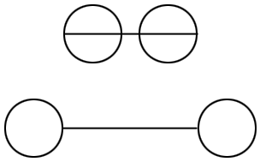
Which line is longer?

Slide 5
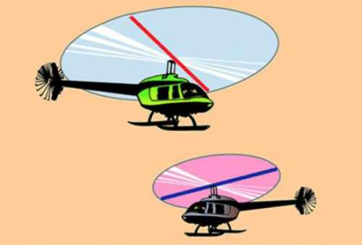

Slide 6
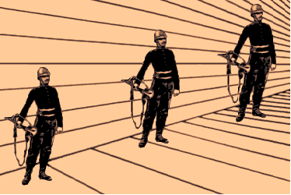

Slide 7
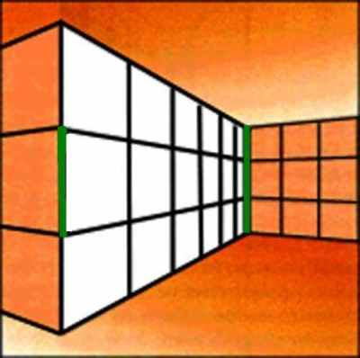

Slide 8

Are the purple lines parallel or curved?

Slide 9

Are the horizontal lines parallel or do they slope?

Slide 10

Count the black dots.

Slide 11
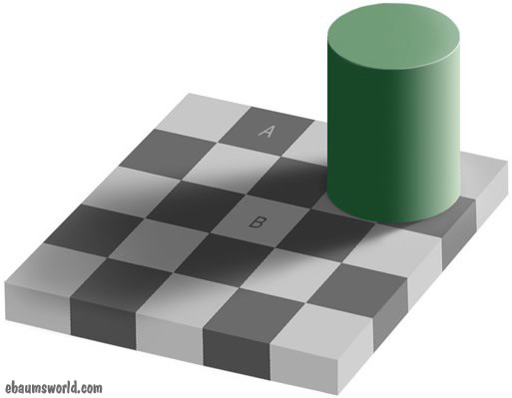
Are the squares above marked A & B the same color or different?

Slide 12
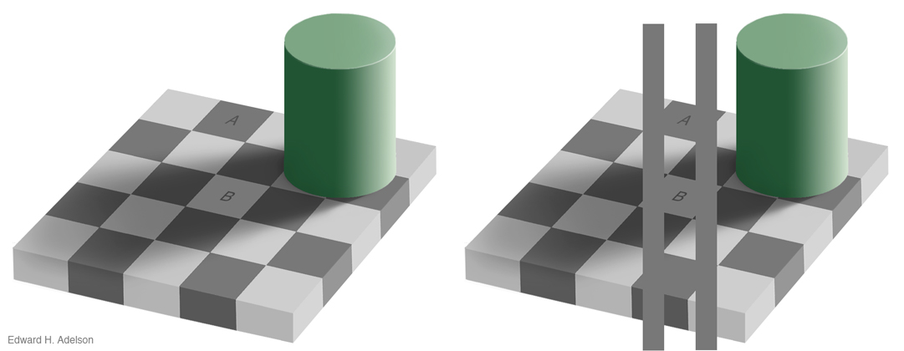
Proof: They are the same. The shadow causes an illusion of white.

Slide 13


Slide 14


Slide 15


Slide 16


Slide 17


Slide 18
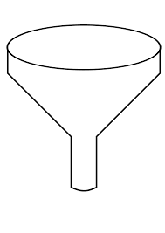



Slide 19
Teams
Committee

Slide 20




Detectives
Lawyers

Slide 21
Holmes and Watson are on a camping trip. In the middle of the night Holmes wakes up and gives Dr. Watson a nudge. “Watson,” he says, “look up in the sky and tell me what you see.”
“I see millions of stars, Holmes,” says Watson.
“And what do you conclude from that, Watson?”

Slide 22
Watson thinks for a moment. “Well,” he says, “astronomically, it tells me that there are millions of galaxies and potentially billions of planets.
Astrologically, I observe that Saturn is in Leo.
Horologically, I deduce that the time is approximately a quarter past three.
Meteorologically, I suspect that we will have a beautiful day tomorrow.
Theologically, I see that God is all powerful, and we are small and insignificant. Uh, what does it tell you, Holmes?”

Slide 23
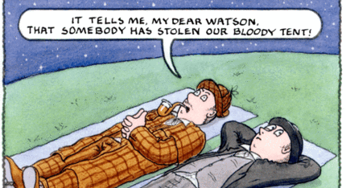

Slide 24
Detectives
Lawyers

Slide 25


Inductive Reasoning
Deductive Reasoning
Reductive Reasoning

Slide 26
Wide Open
Two Sides

Slide 27
Both/And
Either/Or

Slide 28
Young and Old
Young or Old

Slide 29
Good and Evil
Good or Evil

Slide 30
Saints and Sinners
Saints or
Sinners

Slide 31
Wisdom
Knowledge

Slide 32
Americans
Republicans and Democrats

Slide 33
College Football
Clemson or Alabama

Slide 34
Family
“Two shall become One”
Which One?
Mine or Yours?

Slide 35
People
“Us” and “Them”
Us or Them

Slide 36
Hyponyms
Synonyms
Antonyms

Slide 37
COLOR
Shades of Gray
Black
and White

Slide 38
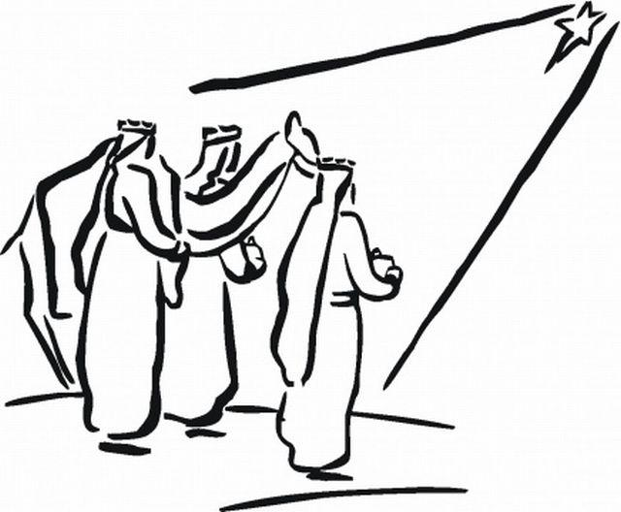
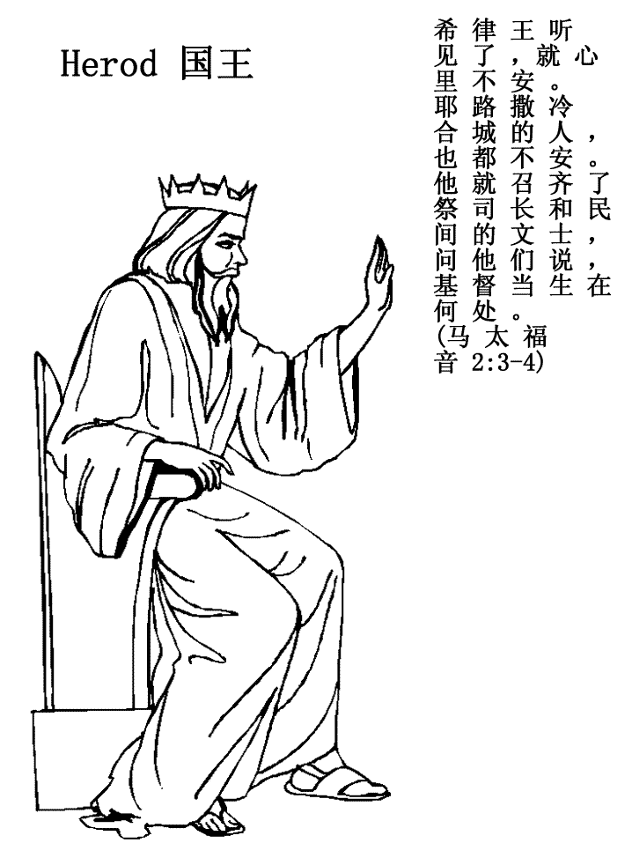

Slide 40



Slide 41
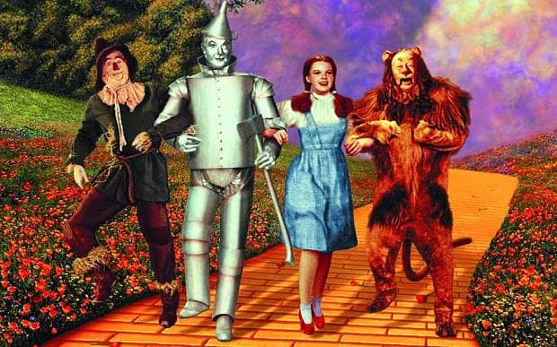


Slide 42
Teams
Committee

Slide 43
Committees Discuss.
Teams Do.

Slide 44
Committees Rule.
Teams Role.

Slide 45


Slide 48
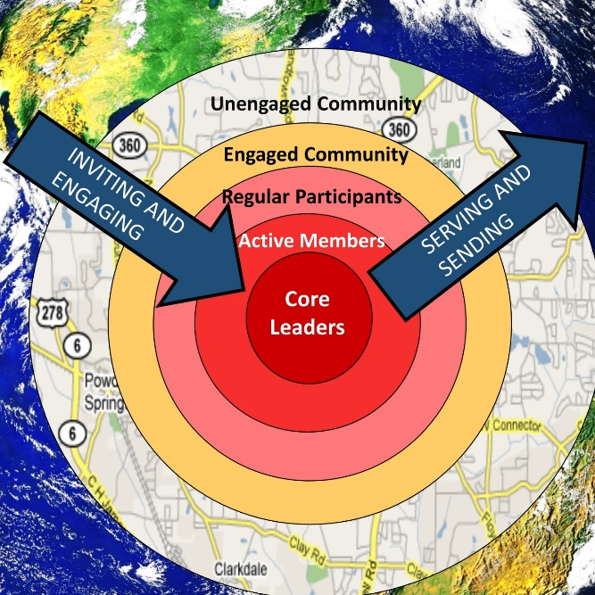
Committees Overfunction.
Teams Engage.

Slide 49
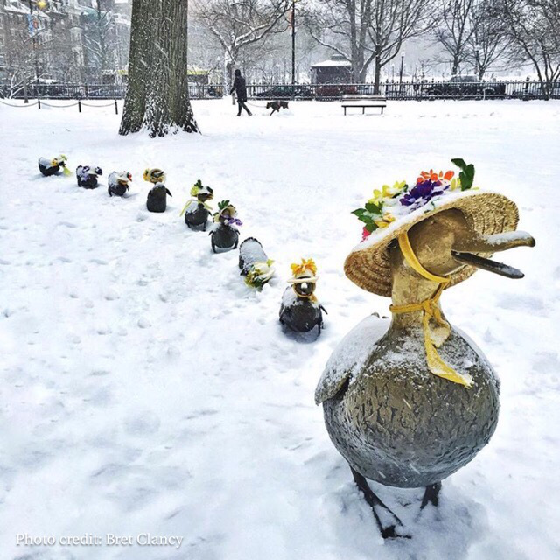
Committees Orthodox.
Teams Practice.
Orthoducksy vs. Orthopraxis

Slide 50
Committees Age.
Teams Mature.
Committees become older while team members become wiser.

Slide 51
Committees Seek Agreement.
Teams Seek Development.
Are you a church of the Like Minded?

Slide 52
Committees Avoid Objections.
Teams Have Objectives.
Does your church have a mission committee but no clear mission?

Slide 53
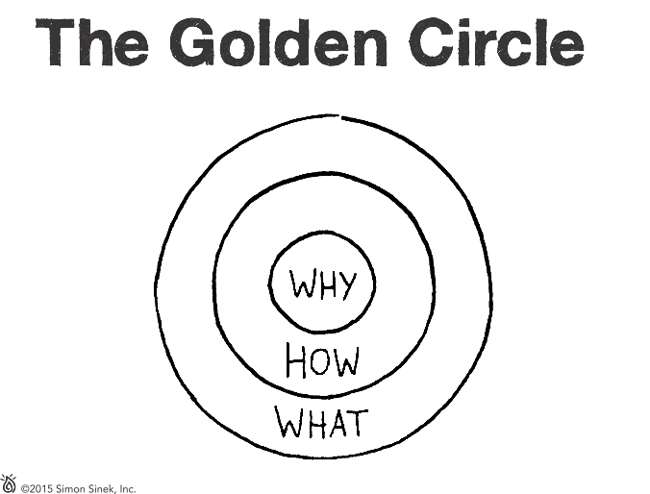
Notes:
Why is it that some leaders and organizations are able to inspire greater loyalty and engagement among their
customers and employees alike? How are they are able to achieve and sustain inordinate amounts of success for years on end?
Whether they realize it or not, all great and inspiring leaders and organizations think, act and communicate in the same way... and it is the complete opposite from everyone else.
Every single organization on the planet, even our own
careers, function on three levels:
1. What we do
2. How we do it, and
3. Why we do it.
When those three pieces are aligned, it gives us a filter through which to make decisions. It provides a
foundation for innovation and for building trust. When all three pieces are in balance, others will say, with
absolute clarity and certainty, “We know who you are,” “We know what you stand for.”
This simple idea is The Golden Circle. It is a concept discovered by optimist and author Simon Sinek.

Slide 54
Notes:
Every organization and individual knows What they do.
For an organization, these are the products they sell or the services they offer. For an individual, it is their job title or roles.

Slide 55
Notes:
Some organizations and individuals know How they do what they do. They may call it their “differentiating value proposition,” “proprietary process” or
“unique selling proposition (USP).” The Hows are an organization’s or individual’s strengths, values or guiding principles. These are the things they feel
set them apart from their competition; the things they think make them special or different from everyone else.

Slide 56
Notes:
Very few people and very few organizations can clearly articulate Why they do what they do. Why is a purpose, a cause or a belief. It provides a clear answer to the questions, “Why do you get out of bed every morning?” “Why does your organization exist?” and “Why should that matter to anyone else?”
Making money is NOT a Why. Revenues, profits, salaries and other monetary measurements are simply results of what we do.
The Why is about our contribution to impact and serve others. The Why inspires us.

Slide 57
Notes:
People naturally communicate from the outside-in; they typically go from what is easiest to understand
to what is hardest to understand and explain. They tell people What they do, tell them How they are
different or better, and then they expect a behavior like a purchase, a vote or support.
Here is how most organizations market and communicate:
What: “Here is our law firm.”
How: “We have the industry’s most intelligent
lawyers, who graduated from the world’s top schools. Have you seen our client list? Only from the Fortune 500! And, check out our offices – they are absolutely pristine.”
Behavior: “Come do business with our law firm!”
The problem is that What and How do not inspire action. Facts and figures make rational sense, but people do not make decisions purely based on facts and figures. Starting with What is what commodities do. Starting with Why is what leaders do.
Leaders inspire.

Slide 58
Notes:
Leaders and organizations with the capacity to inspire all think, act and communicate from the inside-out. They start with their Why. When they communicate their purpose or cause first, they communicate in a way that drives decision-making and behavior.
It literally taps the part of the brain that influences behavior.
Here’s an example with the same law firm, starting with their Why:
Why: “We believe in servicing the needs of others
so that they can focus on the difference
they need to make.“
How: “We do so by bringing on some of the most intelligent legal professionals who graduated from the world’s top schools. We work with top performing organizations, most of which are on the Fortune 500 list, so that we can help them make a larger difference in the world. And, we like to go above and beyond, so we have built pristine offices.”
What: “We are a world-class law firm.
Come see for yourself.”
If the people at this firm actually believe in their Why and think, act and communicate starting with their Why, they will attract people who believe what they believe and who want to be a part of their cause.

Slide 59
Notes:
For The Golden Circle to work properly, you must have:
1. Clarity of Why,
2. Discipline of How, and
3. Consistency of What.
No one section of The Golden Circle is more important than the other. The most important thing is a balance across all three.
WHY:
If you don’t know Why you do What you do, how can you expect anyone else to know? For others to know your Why, you must first have clarity of your own Why.
HOW:
The actions that you and your people take to bring your cause to life must be aligned with your values, guiding principles, strengths and beliefs.
WHAT:
And everything you say and everything you do must be consistent with what you believe. After all, we live in the tangible world. The only way people will know what you believe is if you say and do the things you actually believe.

Slide 60
Churches in
THE WHAT? RUT
Decide by:
Convention
Imitation
Instead of Mission

Slide 61
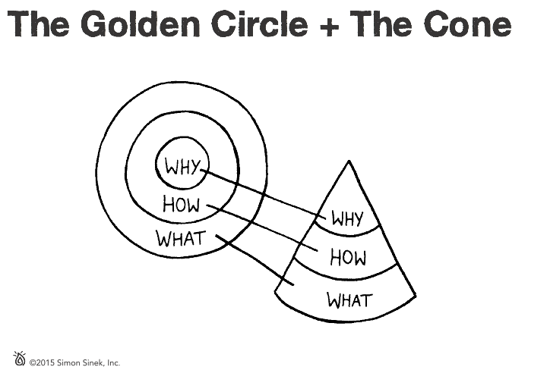
Notes:
The Golden Circle is not just a communication tool; it also provides some insight into how great organizations are structured. If we imagine The Golden Circle as a three-dimensional model, it’s a top down view of a cone.
The cone represents a company or an organization, an inherently organized system. At the top of the system, representing the Why, is a leader. She or he articulates the Why and points to a vision of a better future. The next level down, the How level, includes the people who are inspired by the leader’s cause. They give their blood, sweat and tears to build and bring the vision to life. The What, at the bottom of the cone, are the things the organization says and does that breathe life into the Why. They make it tangible. An organization communicates its Why through everything it says and does; the marketing, the products and services the company provides ... everything.

Slide 62
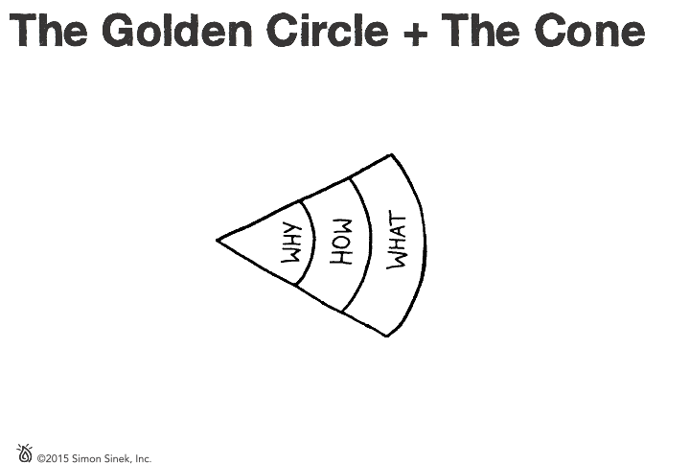
Notes:
For a message to spread, it must be loud AND clear. Like a megaphone.
Loud is easy, just drive sales or buy marketing.
Clear is harder.
When an organization is clear about its purpose or its WHY, everyone, from employees to customers, can understand it. This clarity invites everyone who
interacts with the organization to become champions of the cause, should they choose. Ideally, this clarity starts at the top of the organization and moves through the company. It can inspire people to create products, services, solutions and marketing that brings the Why to life. When everything you say and do echoes what you believe, you end up with a message that’s loud AND clear.

Slide 63
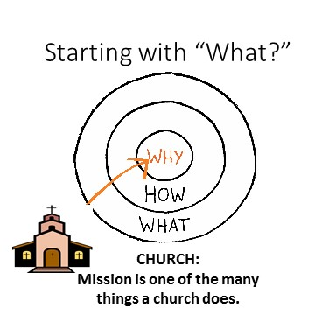
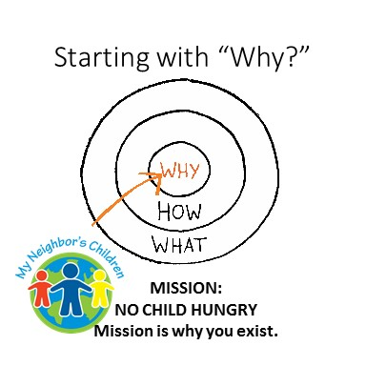

Slide 64
Committees Seek People to Exist.
Teams Exist for People.

Slide 65
Committees Seek to be Charitable.
Teams Will Risk All for The Mission.
Great missions are for the whole world.

Slide 66
Committees Seek People to Exist.
Teams Exist for People.

Slide 67
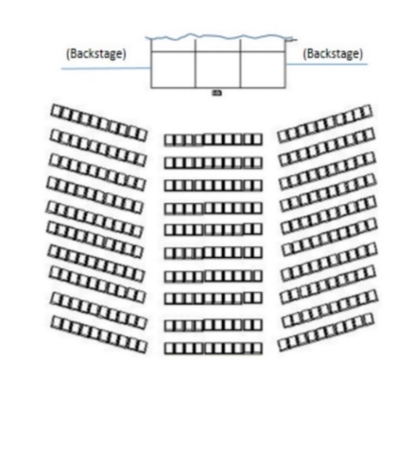
Committees Survey.
Teams Know Their Target Audience.
In this theater church, where would you put,
Preacher
Choir
Congregation
God

Slide 68
HEBREWS 12 Therefore, since we are surrounded by so great a cloud of witnesses, let us also lay aside every weight and the sin that clings so closely, and let us run with perseverance the race that is set before us…

Slide 69
Committees Avoid Endings.
Teams Let One Game End So the Next Can Begin.
Does your church save all it’s minutes but have few moments?

